Slide 1


MULTINATIONAL SCHOOLS DESIGN
| 2024

Slide 2

TEAM MEMBERS
احمد ياسر رزق الصادق
عبدالرحمن علاء حمدي
ايه سامي اسماعيل
اسماء عرفه علي
اسلام احمد سليمان

Slide 3
CONTENT
01
02
03
04
SYSTEM
DESIGN
SYSTEM
ANALYSIS
INTRODUCTION
result

Slide 4
INTRODUCTION
Main Idea of the Project
An Architecture required for one of the big Multinational Schools in Town. They have
2 Buildings in Campus with many teams to support its function also they need to have
their own published website and secure it .
This system aims to:
design a network topology contains the needed devices (switches, routers, access points, …etc)
Put a detailed IP scheme containing subnets and at least 3 vlans in each building for
departments ( Teachers , HR ,Operation)
Configure network devices with the needed configuration included intervlan, OSPF routing .
Configure Web server for the school and choose it’s public IP and configure DNS server.
Apply the required security measurement including : Port security.
test the connectivity using ping, traceroutes…etc and do the needed troubleshooting.

Slide 5

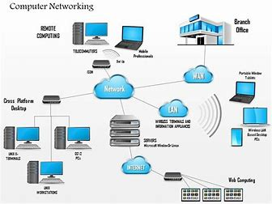

SYSTEM
DESIGN

Slide 6
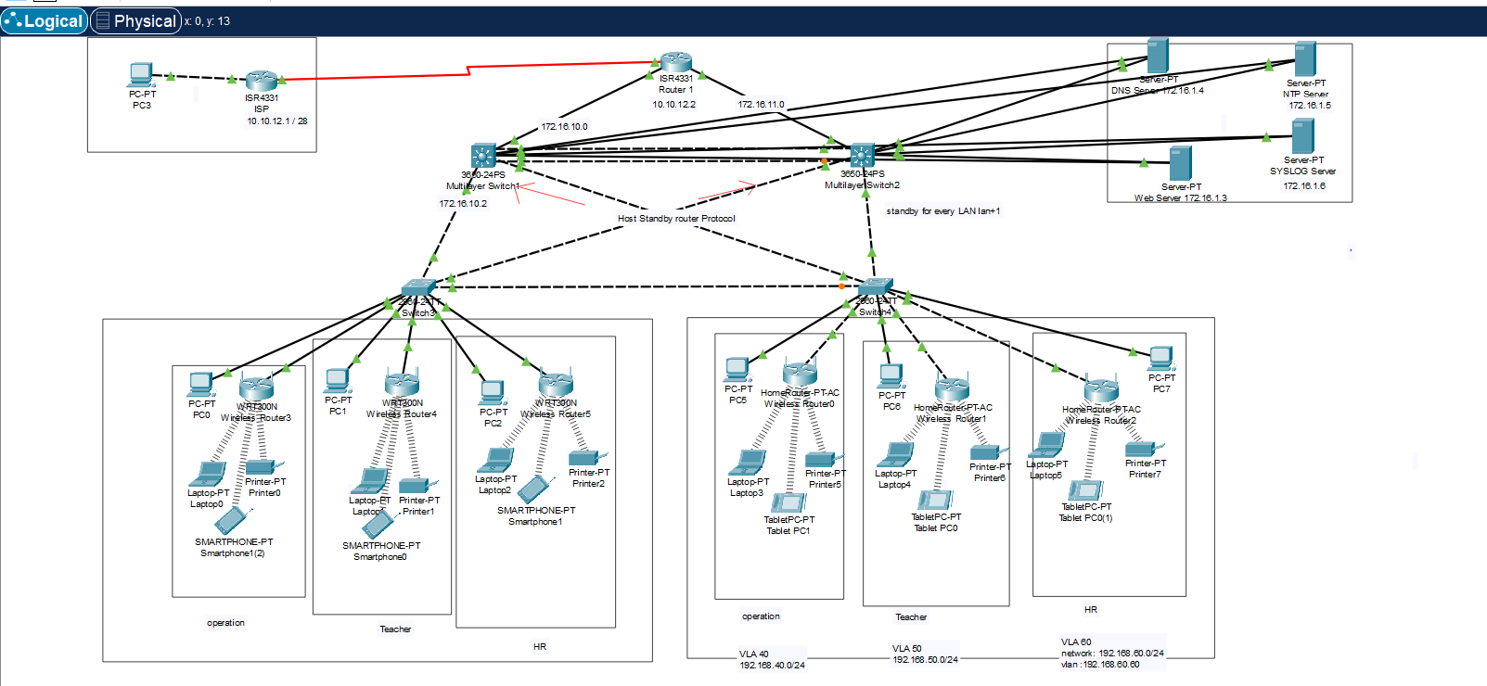

Design

Slide 7
SYSTEM
ANALYSIS

Slide 8

ANALYSIS
Working Principle
design a network topology contains the needed devices (switches, routers, access points, end points…etc)
Put a detailed IP scheme containing subnets and at least 3 vlans in each building for departments ( Teachers, HR, Operation)
Configure servers (DNS, WEB)
Apply the required security measurement including : Port security, NTP server, Syslog server for monitoring logs and ACL to define who is permitted to access web server.
Configure network devices with the needed configuration included intervlan, OSPF routing .
we use protocols (tranck-access-ospf-HSRP-STP).
external secure network(access list) and internal secure(vlan secure)

Slide 9
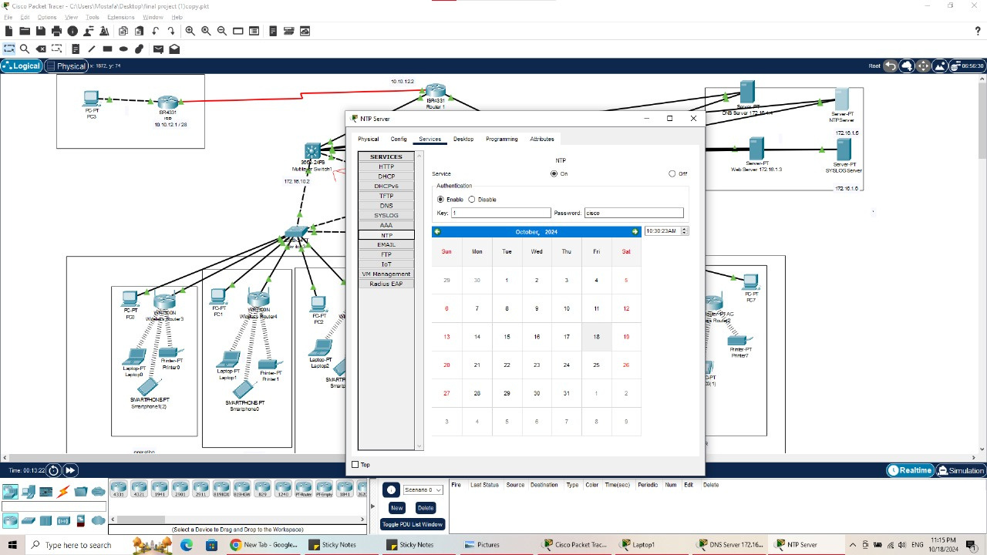
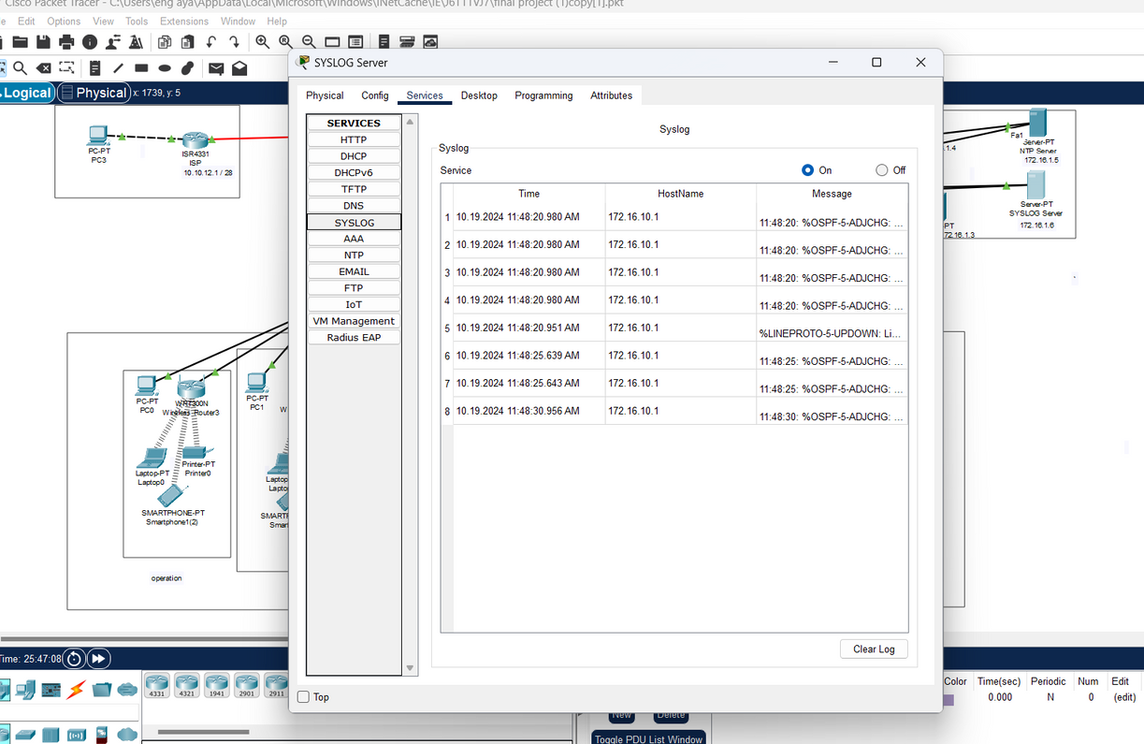
NTP and SYSLOG servers

Slide 10
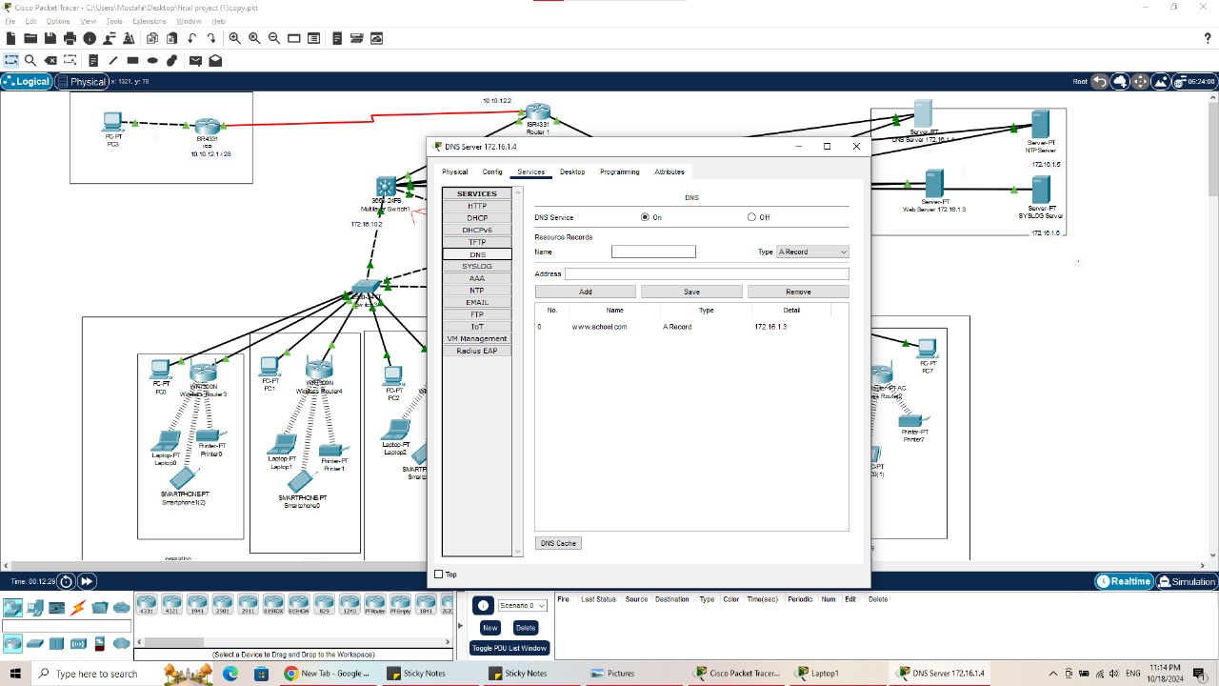
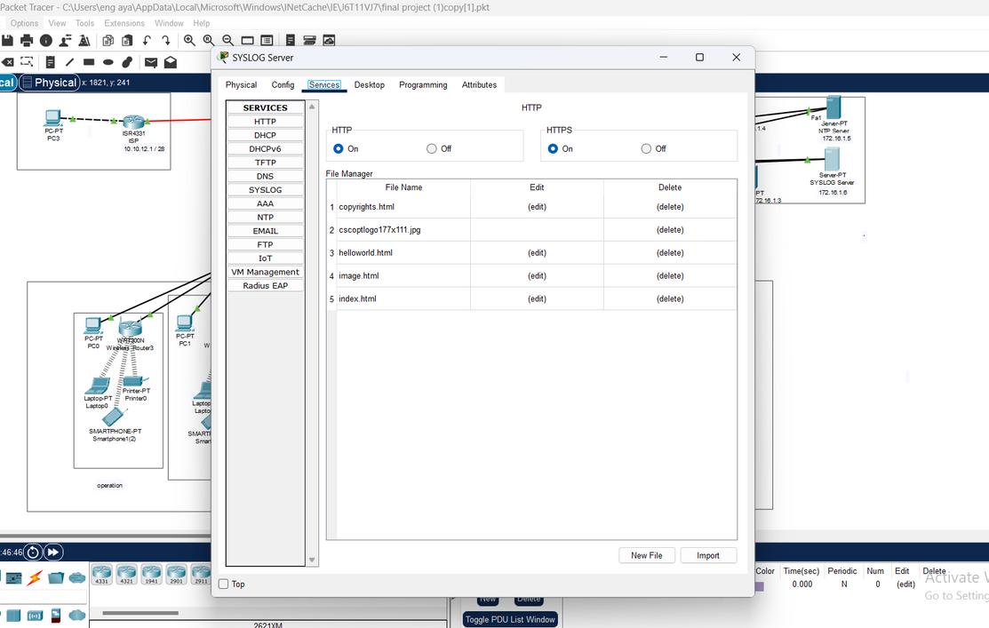
DNS and WEB servers

Slide 11
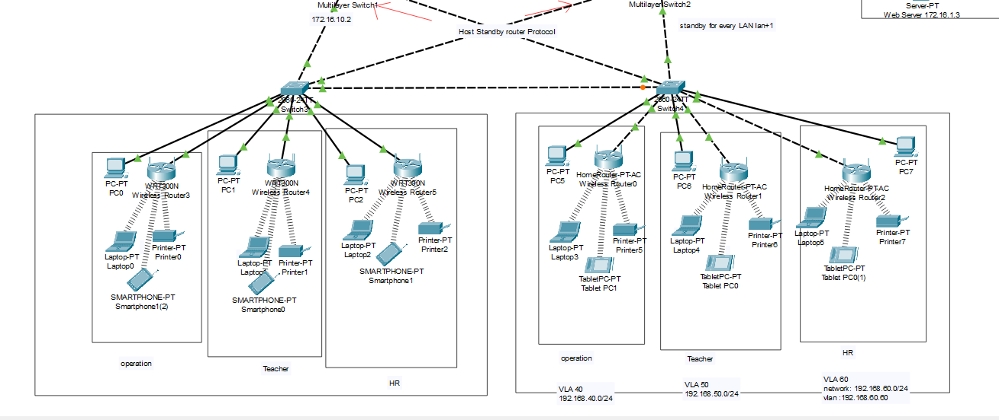
VLANS

Slide 12
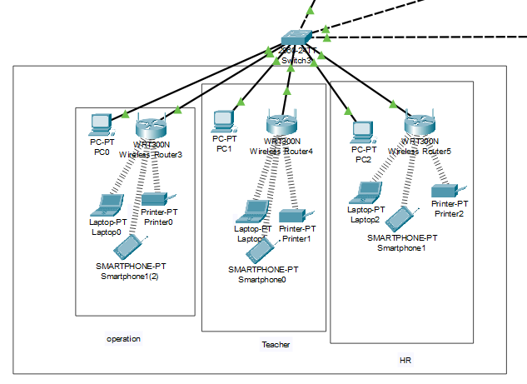
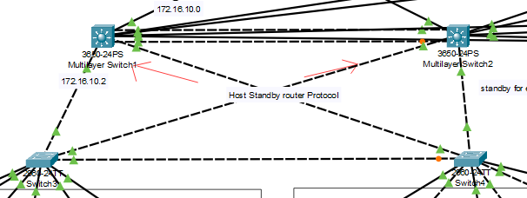
(Tranck-Access) protocols

Slide 13
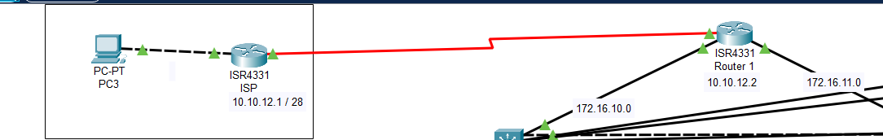
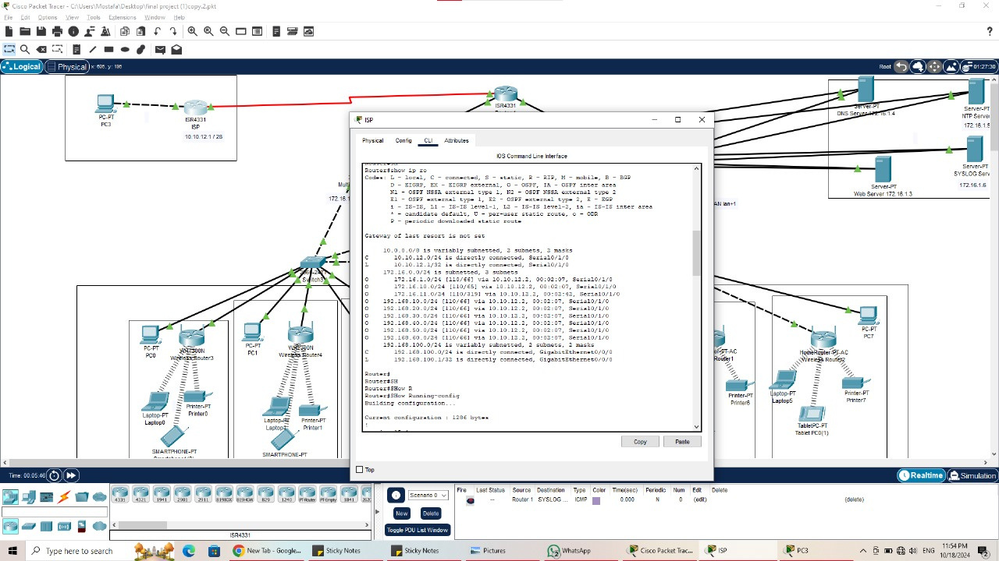
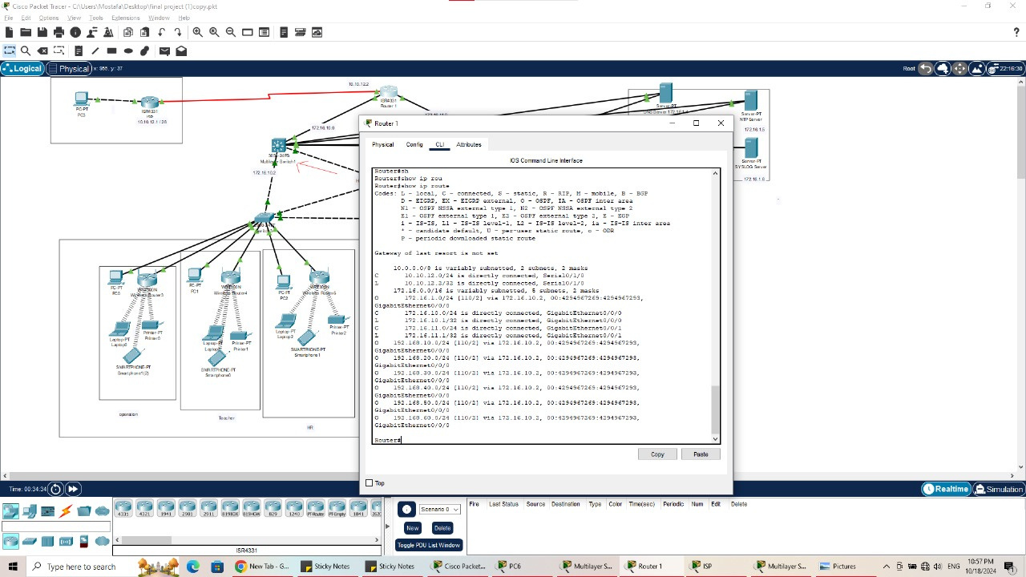
OSPF
protocols

Slide 14
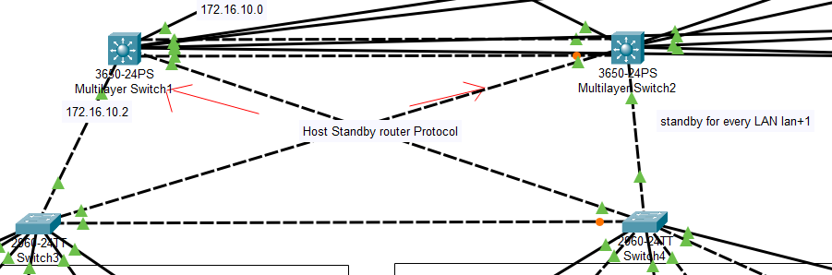
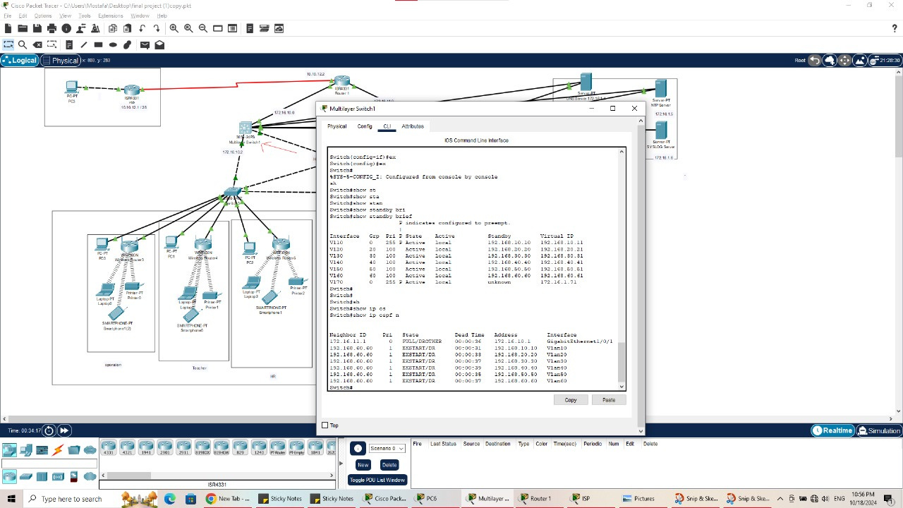
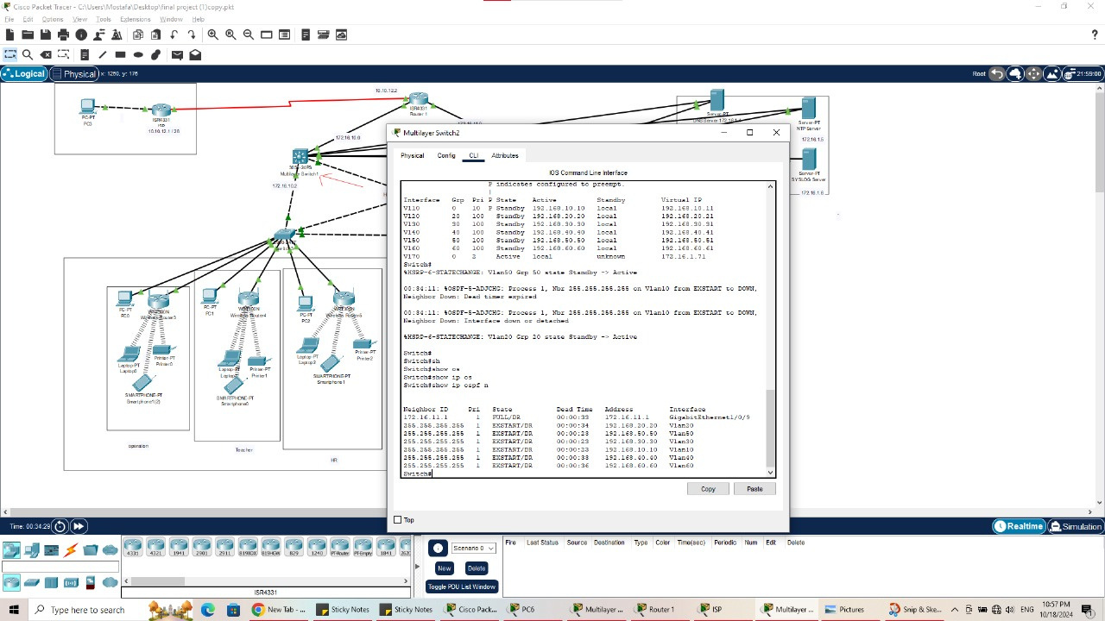
HSRP
protocols

Slide 15
STP)
protocols

Slide 16
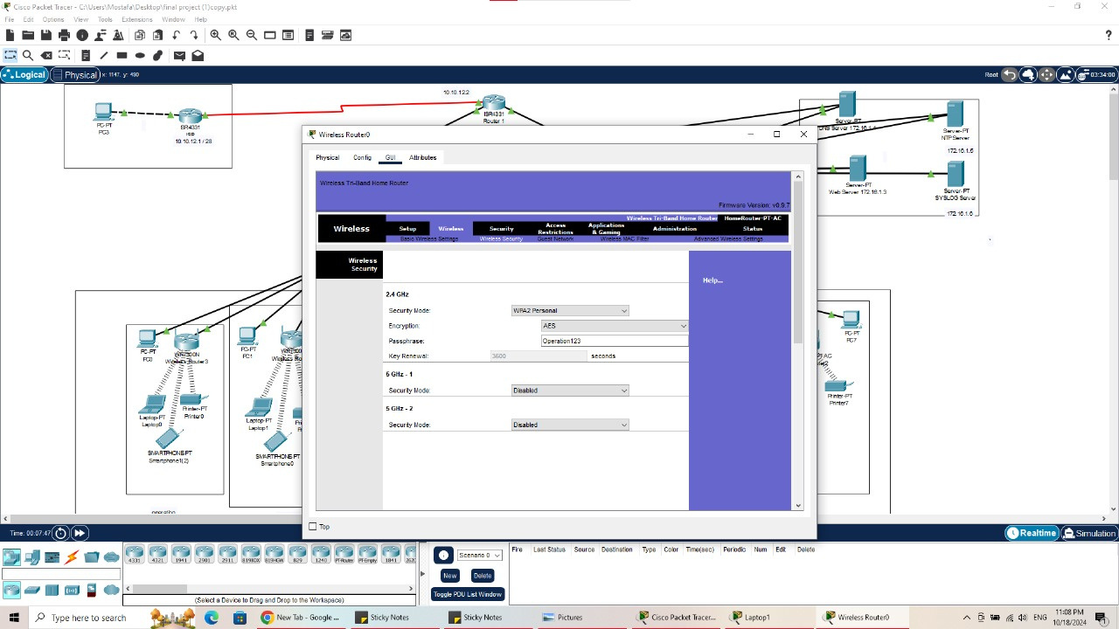
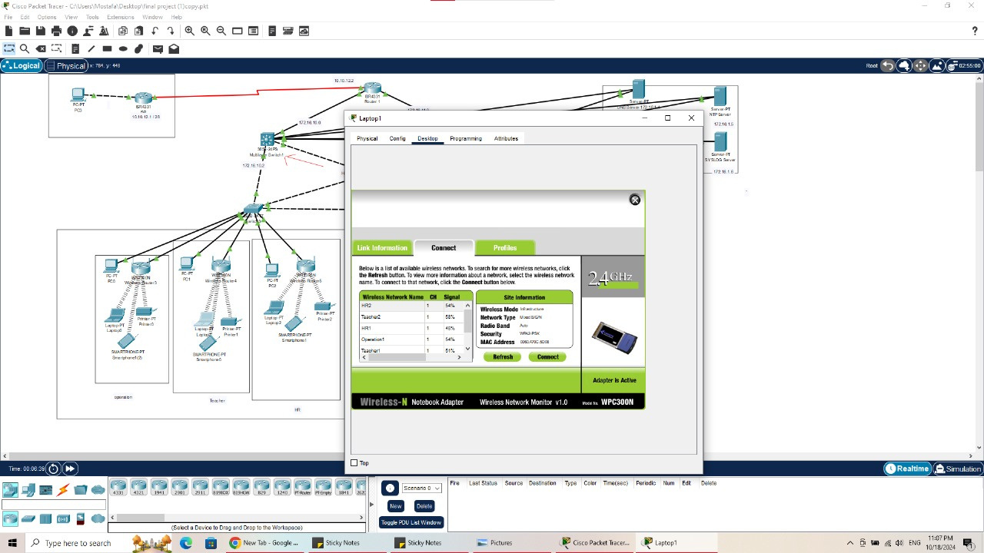
wireless

Slide 17
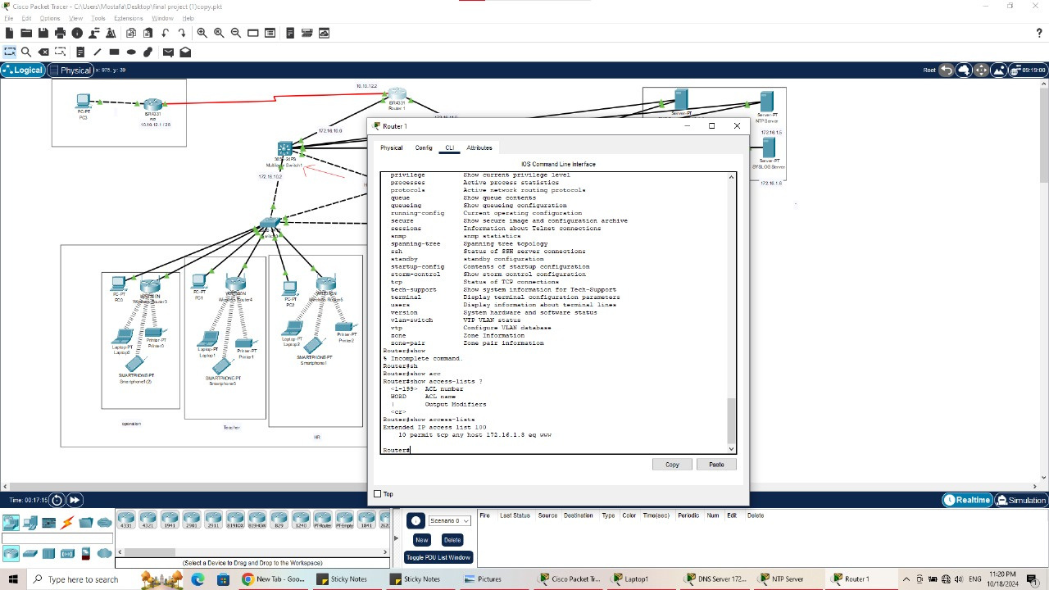
access list

Slide 18
VLAN Secure

